Slide 1
PRODUCTION TECHNOLOGY
(A8315)
Dr. S.ANANTH
PROFESSOR
DEPARTMENT OF MECHANICAL ENGINEERING
VARDHAMAN COLLEGE OF ENGINEERING
HYDERABAD

Slide 2
UNIT-III
HOT WORKING AND COLD WORKING

Slide 3
A8315 - Production Technology Course Outcomes (COs)
After the completion of the course, the student will be able to:
A8315.1. Explain the process of making patterns, preparation of sand mould, various special casting processes and casting defects.
A8315.2. Select appropriate Joining methods to joinWork pieces by using different welding techniques.
A8315.3. Identify various metal forming processes for the various applications.
A8315.4. Describe the properties and bonding techniques of plastics by using plastic molding techniques.
A8315.5. Illustrate the various non-destructive testing methods for a specific application

Slide 4
UNIT III-Course Syllabus
SEE QP 4 (a) Strain hardening, recovery, recrystallisation and grain growth, Comparison of hot working and cold working. Rolling: Theory of rolling, types of Rolling mills, rolling defects,
SEE QP 4 (b) Drawing: wire drawing and Tube drawing, Forging: Types of forging, forging defects. Sheet metal operations. Forces and power requirements in the above processes

Slide 5
1) Dislocations & Plastic deformation and Mechanisms of plastic deformation in metals
Contents
Strengthening mechanisms in metals
Recovery, Recrystallization and Grain growth

Slide 6
Plastic deformation – Dislocations
Permanent plastic deformation is due to shear process – atoms change their neighbors.
Inter-atomic forces and crystal structure plays an important role during plastic deformation.
Cumulative movement of dislocations leads to gross plastic deformation.
Edge dislocation move by slip and climb, while screw dislocation move by slip and cross-slip.
During their movement, dislocations tend to interact. The interaction is very complex because of number of dislocations moving over many slip systems in different directions.

Slide 7
Plastic deformation – Dislocations (contd…)
Dislocations moving on parallel planes may annihilate each other, resulting in either vacancies or interstitials.
Dislocations moving on non-parallel planes hinder each other’s movement by producing sharp breaks – jog (break out of slip plane), kink (break in slip plane)
Other hindrances to dislocation motion – interstitial and substitutional atoms, foreign particles, grain boundaries, external grain surface, and change in structure due to phase change.
Material strength can be increased by arresting dislocation motion.

Slide 8
Plastic deformation mechanisms - Slip
Mainly two kinds: slip and twinning.
Slip is prominent among the two. It involves sliding of
blocks of crystal over other along slip planes.
Slip occurs when shear stress applied exceeds a critical
value.
Slip occurs most readily in specific directions (slip
directions) on certain crystallographic planes.
Feasible combination of a slip plane together with a slip direction is considered as a slip system.
During slip each atom usually moves same integral number of atomic distances along the slip plane.

Slide 9
Plastic deformation mechanisms – Twinning
It results when a portion of crystal takes up an orientation that is related to the orientation of the rest of the untwined lattice in a definite, symmetrical way.
The important role of twinning in plastic deformation is that it causes changes in plane orientation so that further slip can occur.
Twinning also occurs in a definite direction on a specific plane for each crystal structure.

Slide 10
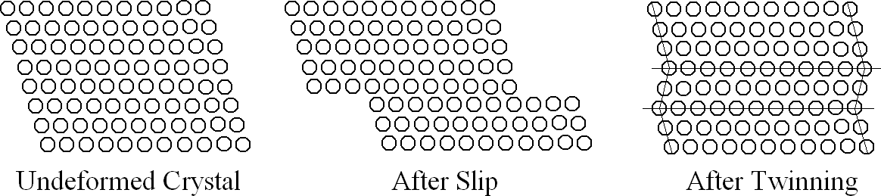
Slip Vs. Twinning
 | during/in slip | during/in twinning
Crystal orientation | Same above and below the slip plane | Differ across the twin plane
Size (in terms of inter- atomic distance) | Multiples | Fractions
Occurs on | Widely spread planes | Every plane of region involved
Time required | Milli seconds | Micro seconds
Occurrence | On many slip systems simultaneously | On a particular plane for each crystal

Slide 11
Strengthening mechanisms
Material can be increased by hindering dislocation, which is responsible for plastic deformation.
Different ways to hinder dislocation motion / Strengthening mechanisms:
in single-phase materials
Grain size reduction
Solid solution strengthening
Strain hardening
in multi-phase materials
Precipitation strengthening
Dispersion strengthening
Fiber strengthening
Martensite strengthening

Slide 12




Strengthening Mechanisms
The ability of a metal/ alloy to plastically deform depends on the ability of dislocations to move.
Strengthening techniques rely on restricting dislocation motion to render a harder and stronger material.
Solid solution strengthening
Grain boundary strengthening
Strengthening mechanism
Precipitation hardening
Cold working

Slide 13
Strain hardening
Phenomenon where ductile metals become stronger and harder when they are deformed plastically is called strain hardening or work hardening.
Increasing temperature lowers the rate of strain hardening. Hence materials are strain hardened at low temperatures, thus also called cold working.
During plastic deformation, dislocation density increases. And thus their interaction with each other resulting in increase in yield stress.
Dislocation density (ρ) and shear stress (τ) are related as follows:
τ = τ ₀ + A ρ

Slide 14
Strain hardening (contd…)
During strain hardening, in addition to mechanical properties physical properties also changes:
a small decrease in density
an appreciable decrease in electrical conductivity
small increase in thermal coefficient of expansion
increased chemical reactivity (decrease in corrosion
resistance).
Deleterious effects of cold work can be removed by heating the material to suitable temperatures – Annealing. It restores the original properties into material. It consists of three stages – recovery, recrystallization and grain growth.
In industry, alternate cycles of strain hardening and annealing are used to deform most metals to a very great extent.

Slide 15
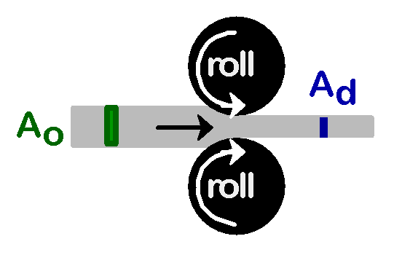


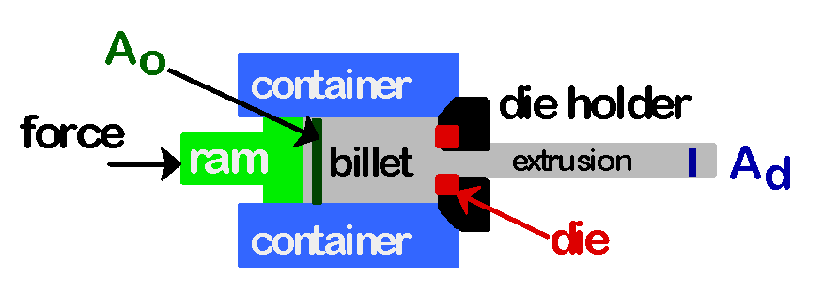
Strain hardening (cold work) (contd…)
Room temperature deformation.
Common forming techniques used to change the cross sectional area:
-Forging -Rolling
force
die
A _{o} blank
A _{d}
force
-Extrusion
-Drawing
die
A _{d}
tensile force
A _{o}
die

Slide 16
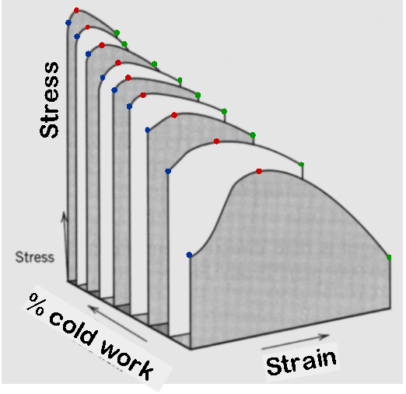
Strain Hardening
Strain hardening or cold working is esp. used to harden alloys that do not respond to heat treatment.
The rate of strain hardening is lower in HCP than in cubic metals.
Strength
Cold work
Ductility

Slide 17
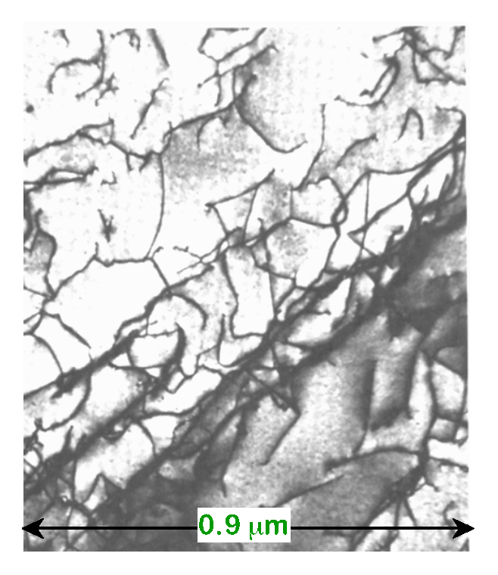
Cold Working
Cold-work structure occurs when plastic deformation is applied in a temperature region such that the strain hardening is not relieved (0.3 - 0.5 T_{m}).
Cold worked structure con t ai n s d i slocat i on ~10⁸-10¹⁰mm⁻²,while an n ealed st r uct ur e possesses ~10³-10⁴ mm⁻².
Dislocations entangle with one another during cold work. Hence dislocation
motion becomes more difficult.
As T , strain rate
stored energy

Slide 18
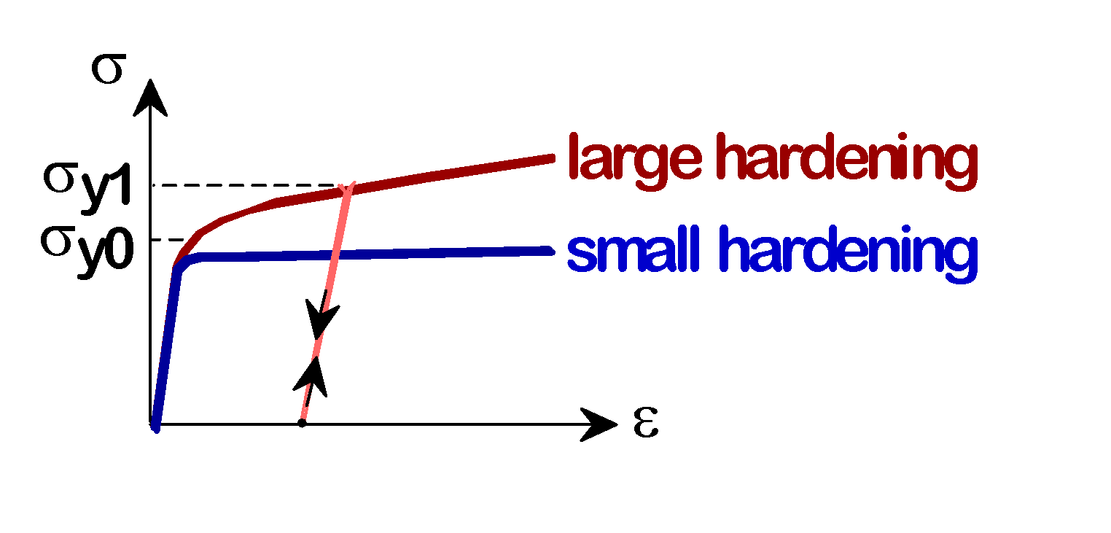
Result of Cold Work
Dislocation density increases, which leads to a increase in yield strength: Materials becomes harder.
Ductility and tensile strength also increases.

Slide 19
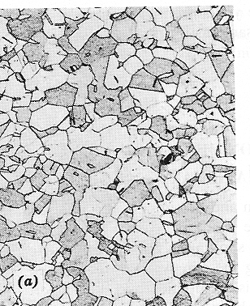
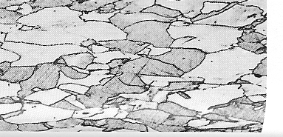
Anisotropy in σ_{yield}
Can be induced by rolling a polycrystalline metal
-before rolling
-after rolling
rolling direction
235 mm
isotropic
since grains are approx. spherical & randomly oriented.
anisotropic
since rolling affects grain orientation and shape.

Slide 20
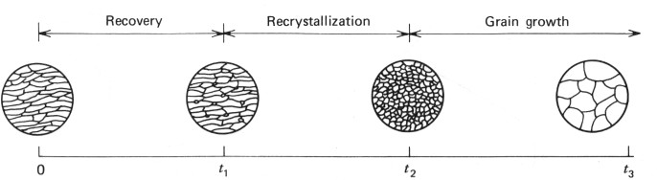
Annealing of Cold-Worked Metal
Annealing of the cold worked structure at high temperature softens the metal and reverts to a strain- free condition.
The transformations that take place during annealing are recovery, recrystallization and grain growth, respectively.
The driving force for recovery and recrystallization is the energy of the defects introduced during cold working (stored energy of the deformed matrix).
The driving force for grain growth is the boundary curvature.

Slide 21
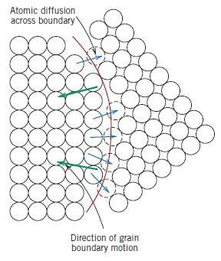
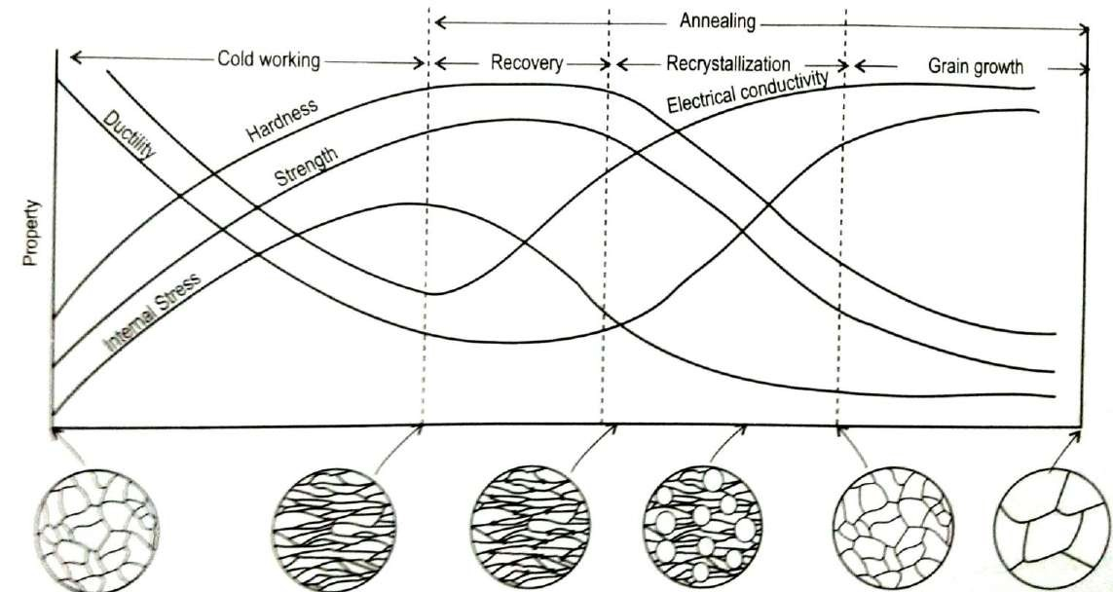

Slide 22



Annealing of Cold-Worked Metal
Annealing Temperature (°C)
100 300 500
600
tensile strength
700
60
tensile strength (MPa)
50
500
ductility (%EL)
40
400
30
ductility
20
300
3 Annealing stages
Effect of 1 hour heating on mechanical properties

Slide 23
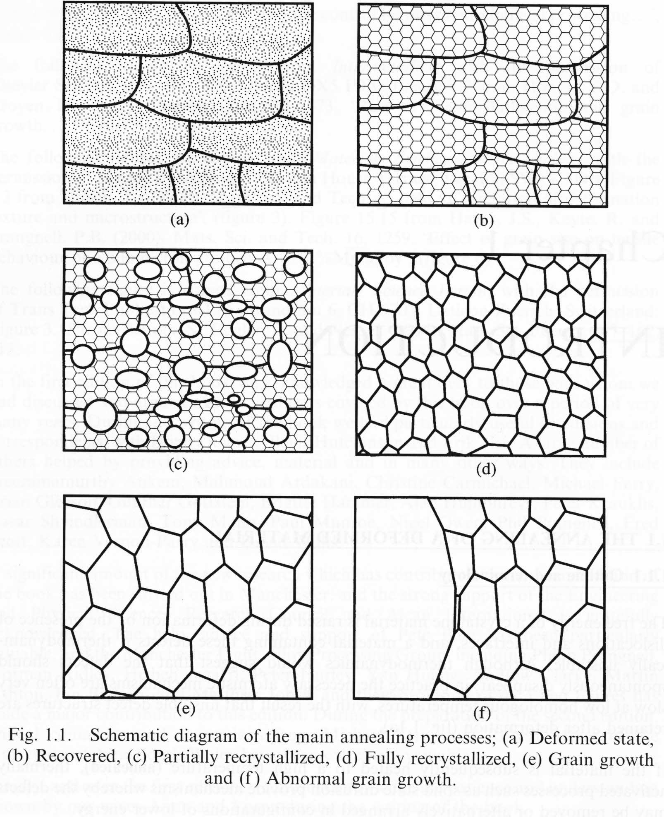
Recovery
Recrystallization nucleation and growth of strain free grains
Grain growth

Slide 24
Recovery
Annealing relieves the stresses from cold working – three stages: recovery, recrystallization and grain growth.
Recovery involves annihilation of point defects.
Driving force for recovery is decrease in stored energy from cold work.
During recovery, physical properties of the cold-worked material are restored without any observable change in microstructure.
Recovery is first stage of annealing which takes place at low temperatures of annealing.
There is some reduction, though not substantial, in dislocation density as well apart from formation of dislocation configurations with low strain energies.

Slide 25
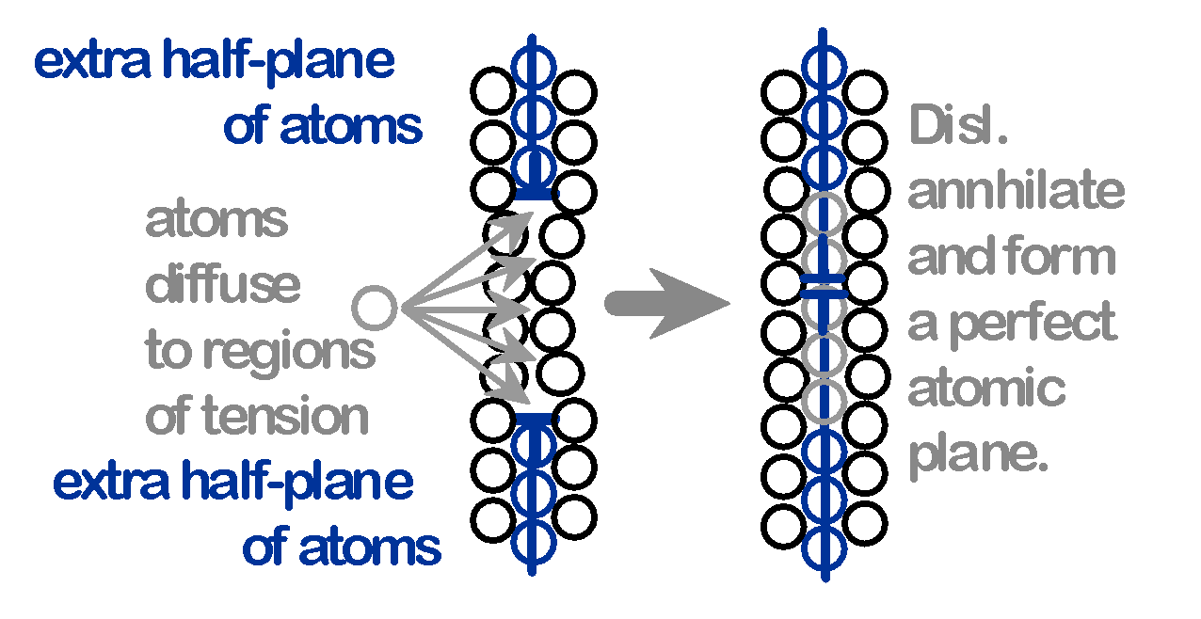
Recovery
During recovery, some of the stored internal strain energy is relieved through dislocation motion due to enhanced atomic diffusion at the elevated temperatures.
Leads to reduction in the number of dislocations.

Slide 26
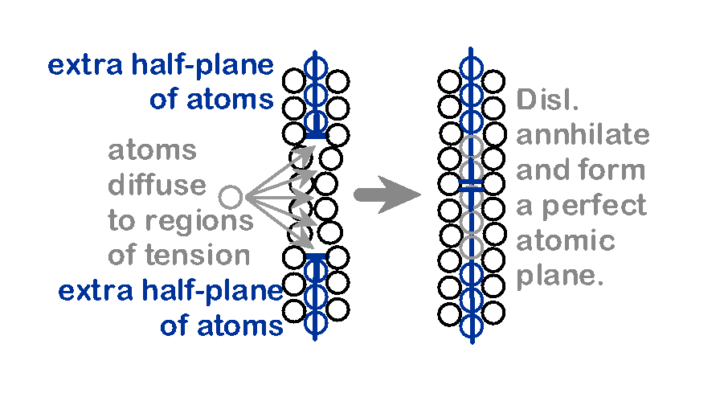
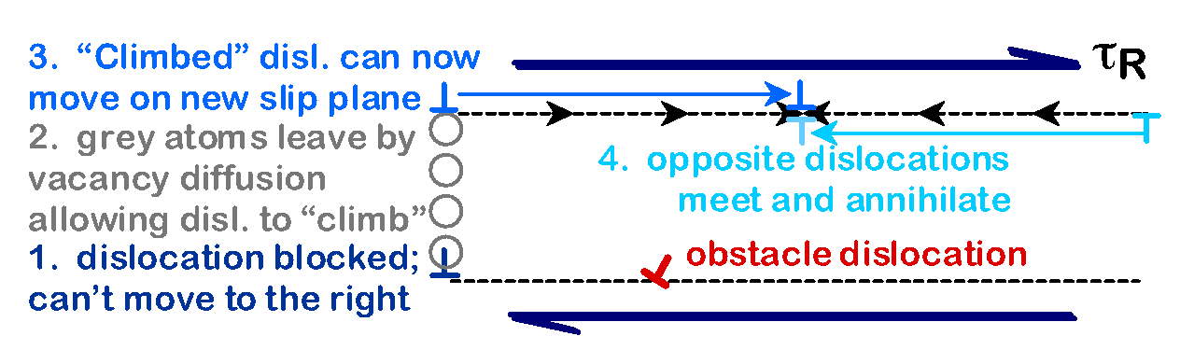
Recovery
Annihilation reduces dislocation density.
Scenario 1
Scenario 2

Slide 27
Recrystallization
This follows recovery during annealing of cold worked material. Driving force is stored energy during cold work.
It involves replacement of cold-worked structure by a new set of strain-free, approximately equi-axed grains to replace all the deformed crystals.
This is process is characterized by recrystallization temperature which is defined as the temperature at which 50% of material recrystallizes in one hour time.
The recrystallization temperature is strongly dependent on the purity of a material.
Pure materials may recrystallizes around 0.3 T_{m}, while impure materials may recrystallizes around 0.5-0.7 T_{m}, where T_{m} is absolute melting temperature of the material.

Slide 28
Recrystallization laws
A minimum amount of deformation is needed to cause recrystallization (Rx).
Smaller the degree of deformation, higher will be the Rx temperature.
The finer is the initial grain size; lower will be the Rx temperature.
The larger the initial grain size, the greater degree of deformation
is required to produce an equivalent Rx temperature.
Greater the degree of deformation and lower the annealing
temperature, the smaller will be the recrystallized grain size.
The higher is the temperature of cold working, the less is the strain energy stored and thus Rx temperature is correspondingly higher.
The Rx rate increases exponentially with temperature.

Slide 29
Recrystallization
After recovery is complete, the grains are still in a relatively high strain energy state.
Recrystallization is the formation of a new set of strain- free and uniaxial grains that have low dislocation densities.
The driving force to produce the new grain structure is the internal energy difference between strained and unstrained material.
The new grains form as very small nuclei and grow until they consume the parent material.

Slide 30
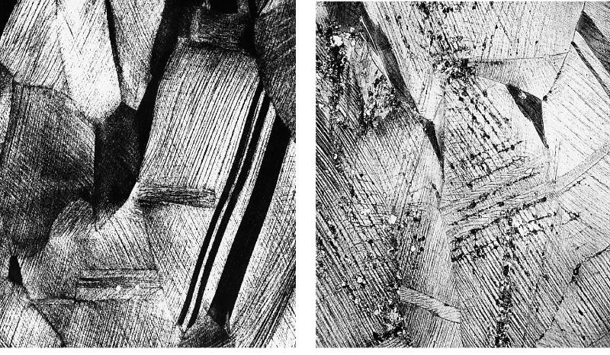
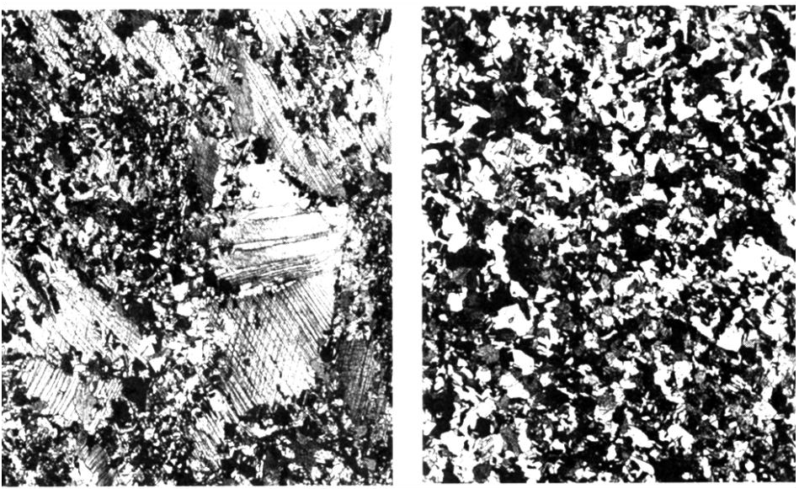
Recrystallization Illustration
Cold Worked grains. Not annealed.
Initial recrystallization after 3 seconds @ 580˚C
Partial replacement of grains, after 4 seconds
Complete recryst. after 8 seconds

Slide 31
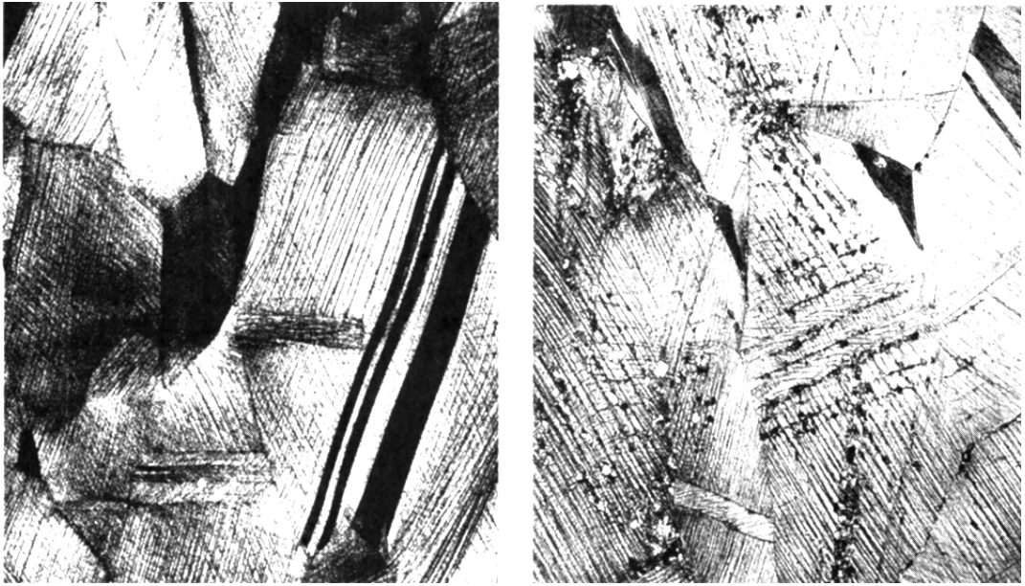
Recrystallization
New crystals are formed that:
have a small dislocation density are small
consume cold-worked crystals.
0.6 mm
0.6 mm
33% cold worked brass
New crystals nucleate after 3 sec. at 580C.

Slide 32
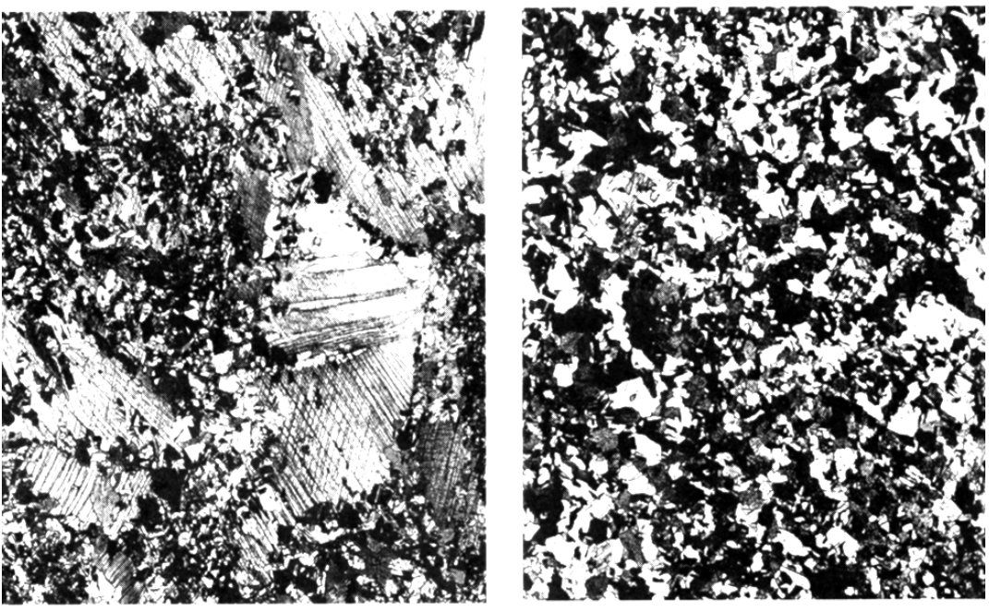
Further Recrystallization
All cold-worked crystals are consumed.
0.6 mm
0.6 mm
After 4 seconds
After 8 seconds

Slide 33
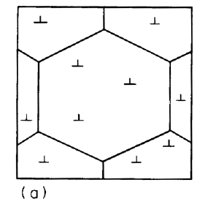
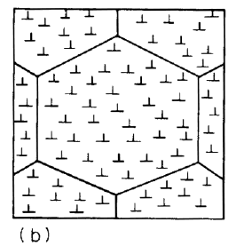
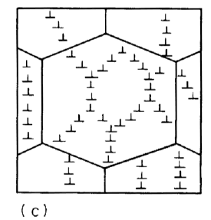
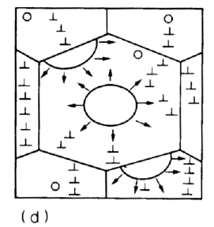
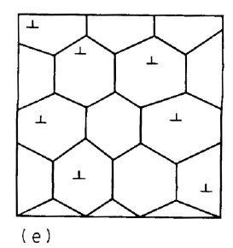
Cold Working and Annealing
Starting material with low dislocation density
Cold-worked material has greatly increased dislocation density
Annealing leads to recovery
Further annealing leads to nucleation and growth of new grains
Fully recrystallized metal with new (smaller) strain-free grains
The recrystallization behavior of a particular metal alloy is sometimes specified in terms of a
recrystallization temperature, the temperature at which recrystallization just reaches completion in 1 h.
Typically, it is between one-third and one-half of the absolute melting temperature of a metal or
alloy and depends on several factors,

Slide 34
Grain growth
Grain growth follows complete crystallization if the material is left at elevated temperatures.
Grain growth does not need to be preceded by recovery and recrystallization; it may occur in all polycrystalline materials.
In contrary to recovery and recrystallization, driving force for this process is reduction in grain boundary energy.
Tendency for larger grains to grow at the expense of smaller grains is based on physics.
In practical applications, grain growth is not desirable.
Incorporation of impurity atoms and insoluble second phase
particles are effective in retarding grain growth.
Grain growth is very strongly dependent on temperature.

Slide 35
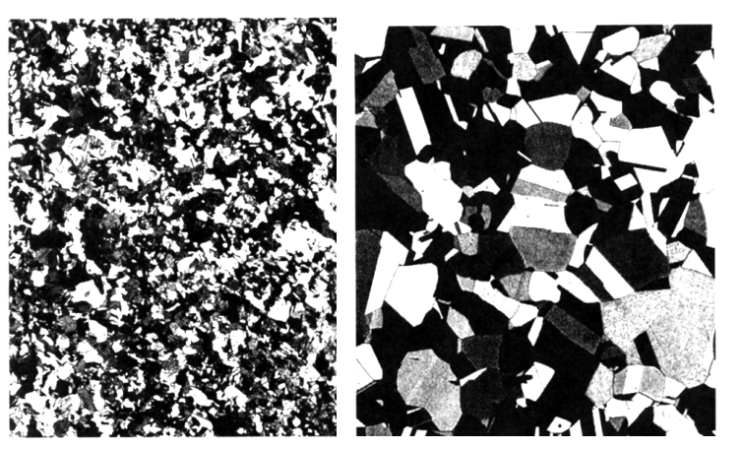

Grain Growth
At longer times, larger grains consume smaller ones.
Grain boundary area (and therefore energy) is reduced.
0.6 mm
0.6 mm
After 8 s, 580C
After 15 min, 580C

Slide 36
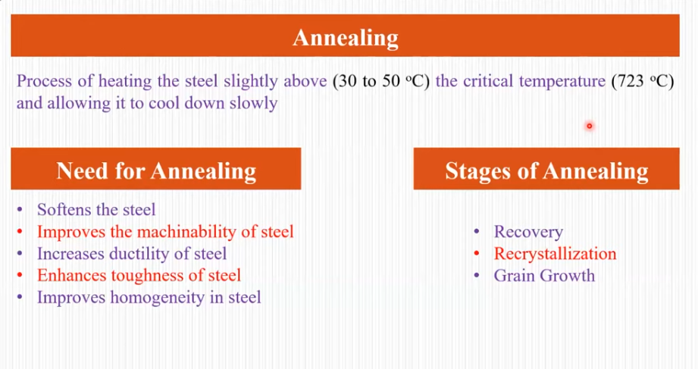

Slide 37
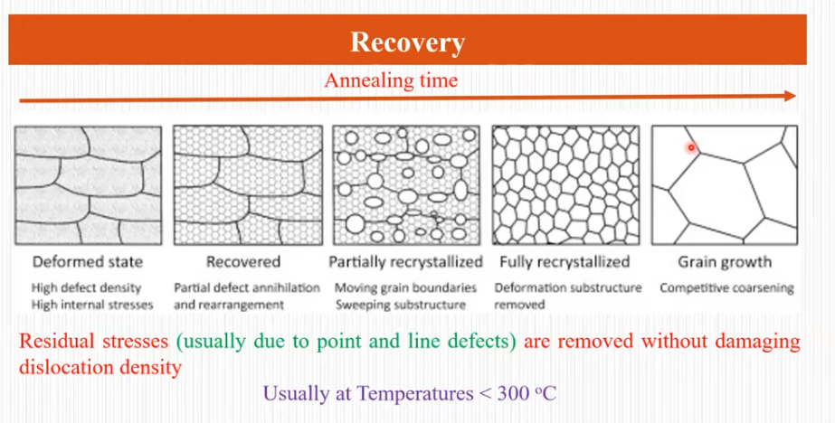

Slide 38
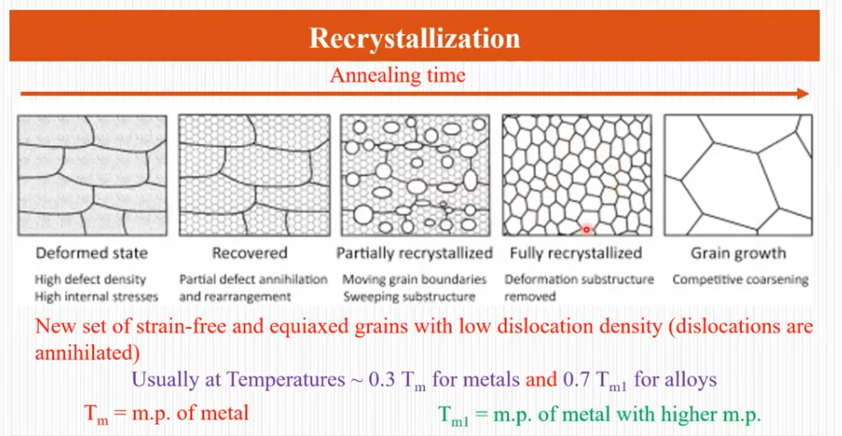

Slide 39
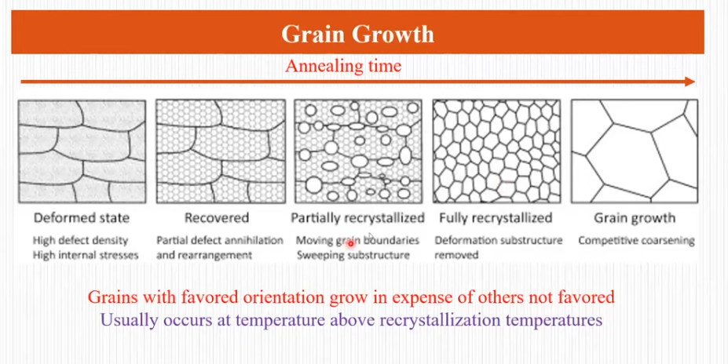

Slide 40
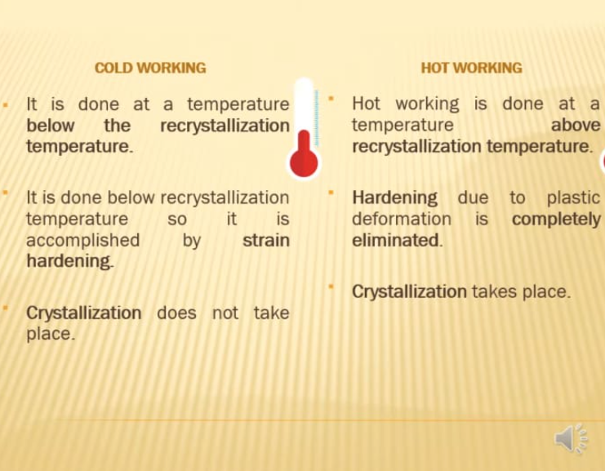

Slide 41
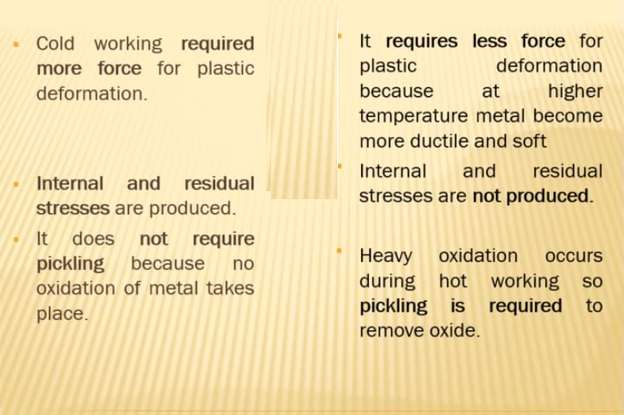

Slide 42
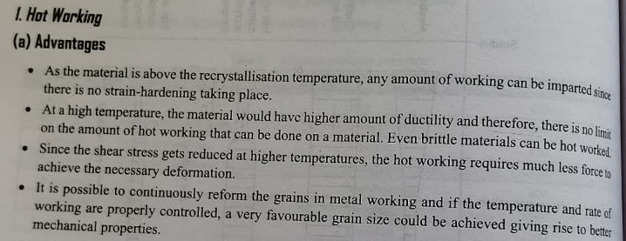

Slide 43
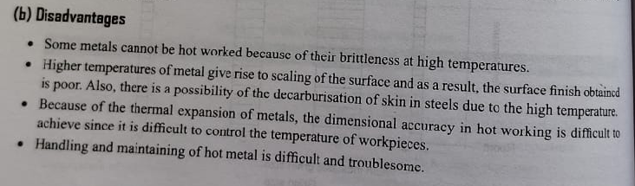

Slide 44
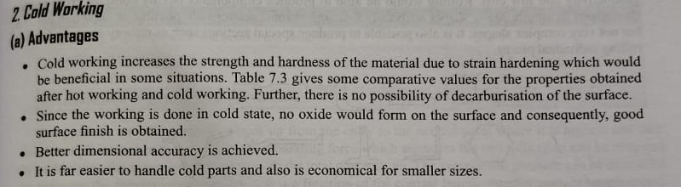
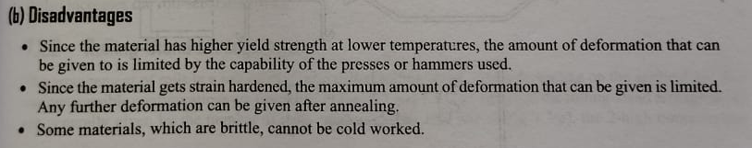

Slide 45
Strain hardening is a process that makes a material harder and stronger by deforming it plastically. It's also known as work hardening or cold working.
"recovery" refers to the process where a deformed metal partially relieves internal stress by rearranging dislocations within existing grains without changing the grain structure,
"recrystallization" involves the formation and growth of new, strain-free grains within a deformed material, replacing the original deformed grains, and
"grain growth" is the further enlargement of grains in a material at high temperatures, where larger grains consume smaller ones, occurring after recrystallization is complete;

